Slide 1
University of Missouri System Board of Curators Finance Committee September 2, 2021 FY2021 Investment Performance Review UM

Slide 2
General Investment Consultant
Verus: Founded in 1986; 84 employees; 31 shareholders; 153 clients with $607 billion in assets under advisement; offices in Seattle, San Francisco, Los Angeles and Pittsburgh.
The University’s consulting team continues under the leadership of Verus Chief Executive Officer Jeffrey MacLean.

Slide 3
Investment Office
The Investment Office of the University of Missouri System is responsible for the management and oversight of the University’s Retirement Plan, Endowment Pool and General Pool investment portfolios, in accordance with the University’s Collected Rules and Regulations.
(in $ billions)
Total assets under management increased by $2.3 billion or 26% in FY 2021.

Slide 4
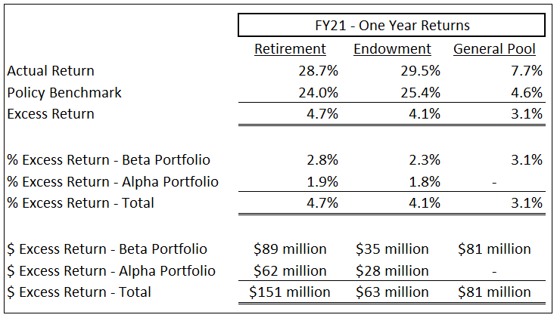
FY21 Performance
Record returns were produced across all three portfolios in FY21, with aggregate net investment income approaching $1.7 billion.
Value created through performance in excess of policy benchmarks totaled nearly $300 million across portfolios.
Two-thirds of excess returns in Retirement and Endowment were generated by our portable alpha program.

Slide 5
Progress Toward Investment Objectives
*Through June 30, 2021

Slide 6
Progress Toward Investment Objectives
*Through June 30, 2021

Slide 7
Summary of FY21 Activity
(As of June 30, 2021 – in $ thousands)
 | Beginning Balance | Contributions or Gifts | Benefits or Distributions | Investment Income | Ending Balance
Retirement Plan | $3,630,000 | $130,000 | ($284,000) | $1,017,000 | $4,493,000
Endowment Pool | $1,732,000 | $87,000 | ($90,000) | $509,000 | $2,238,000
The spending policy for the Endowment Pool is based on a 28-quarter market value average, which provides stability in distributions even in times of market volatility.

Slide 8
One Year Returns by Asset Sector (as of June 30, 2021)
 | Retirement Plan |  |  | Endowment Pool
Asset Sector | Actual | Benchmark | Variance | Actual | Benchmark | Variance
Public Equity | 41.2% | 39.3% | 1.9% | 41.8% | 39.3% | 2.5%
US Treasuries | -1.5% | -1.5% | 0.0% | -1.2% | -1.5% | 0.3%
Inflation-Linked Bonds | 6.5% | 6.6% | -0.1% | 6.7% | 6.6% | 0.1%
Commodities | 47.8% | 35.9% | 11.9% | 54.9% | 45.6% | 9.3%
Risk Balanced | 22.1% | 22.1% | 0.0% | 21.6% | 21.6% | 0.0%
Private Equity | 62.1% | 54.9% | 7.2% | 62.5% | 57.6% | 4.9%
Real Estate | 11.7% | 1.5% | 10.2% | 10.5% | 1.5% | 9.0%
Private Debt | 11.4% | 12.1% | -0.7% | 11.5% | 12.8% | -1.3%
Total Beta Portfolio | 26.8% | 24.0% | 2.8% | 27.7% | 25.4% | 2.3%
Alpha Portfolio | 7.8% | - | 1.9% | 7.7% | - | 1.8%
Total Portfolio | 28.7% | 24.0% | 4.7% | 29.5% | 25.4% | 4.1%

Slide 9
One Year Contribution to Total Return
 | Retirement Plan | Endowment Pool
Public Equity | 13.8% | 14.6%
Private Equity | 5.8% | 5.9%
Risk Balanced | 2.9% | 2.7%
Commodities | 2.1% | 2.3%
Alpha Portfolio | 1.9% | 1.8%
Inflation-Linked Bonds | 0.9% | 0.9%
Real Estate | 0.9% | 0.9%
Private Debt | 0.6% | 0.5%
US Treasuries | -0.2% | -0.1%
Total Portfolio | 28.7% | 29.5%
Contribution to Total Return is a function of asset class return and weighting within the investment portfolio. As an example, in the Retirement Plan, Commodities returned 48% for the year at an average portfolio weight of 4.4% (48% x 4.4% = 2.1%).

Slide 10
Longer-Term Returns
(as of June 30, 2021)
 | Retirement Plan |  | Endowment Pool
 | Actual | Benchmark | Actual | Benchmark
5 Year | 10.8% | 10.1% | 11.5% | 10.6%
7 Year | 7.7% | 7.3% | 8.4% | 7.8%
10 Year | 8.1% | 8.1% | 8.6% | 8.4%
Longer-term returns are all at, or comfortably above, policy benchmarks.

Slide 11
General Pool - Portfolio Returns
(Year Ended June 30, 2021)
 | Mix 6/30/21 | FY21 | Benchmark | Excess
Liquidity Portfolio | 37% | 0.2% | 0.1% | 0.1%
Core Portfolio | 34% | 7.1% | 0.1% | 7.0%
Strategic Portfolio | 29% | 19.1% | 18.1% | 1.0%
Total General Pool | 100% | 7.7% | 4.6% | 3.1%
The General Pool delivered historic returns in FY21, despite one-third of the portfolio held in cash equivalents at near-zero rates. Driven largely by active management within the Core Portfolio and strong results in the Strategic Portfolio, the General Pool produced strong absolute returns which were 3.1% above the policy benchmark. These excess returns equate to approximately $81 million in value creation. Bottom line is that the General Pool produced a record strategic dividend of $56.5 million.

Slide 12
Retirement Plan Guidance – Plan Year End
Actuarial calculations utilize an investment return assumption of 7.20%, measured each year at September 30th
Quarterly Performance for the Year Ended June 30, 2021 |  | Estimated Performance for the 10 Months Ended July 31, 2021
September 30, 2020 | 5.6%
December 31, 2020 | 9.1% | December 31, 2020 | 9.1%
March 31, 2021 | 4.0% | March 31, 2021 | 4.0%
June 30, 2021 | 7.4% | June 30, 2021 | 7.4%
Annualized Return | 28.7% | July 31, 2021 | 1.03%
 |  | 10 Months through July 31, 2021 | 22.87%

Slide 13
Questions?

